Slide 1
Relational Algebra & Relational Calculus
Lucas Cordova
Oregon Institute of Technology

Slide 2
Learning Objectives
5.1 Meaning of the term relational completeness.
5.2 How to form queries in relational algebra.
5.3 How to form queries in tuple relational calculus.
5.4 How to form queries in domain relational calculus.
5.5 Categories of relational D M L.

Slide 3
Introduction
Relational algebra and relational calculus are formal languages associated with the relational model.
Informally, relational algebra is a (high-level) procedural language and relational calculus a non-procedural language.
However, formally both are equivalent to one another.
A language that produces a relation that can be derived using relational calculus is relationally complete.

Slide 4
Relational Algebra (1 of 2)
Relational algebra operations work on one or more relations to define another relation without changing the original relations.
Both operands and results are relations, so output from one operation can become input to another operation.
Allows expressions to be nested, just as in arithmetic. This property is called closure.

Slide 5
Relational Algebra (2 of 2)
Five basic operations in relational algebra: Selection, Projection, Cartesian product, Union, and Set Difference.
These perform most of the data retrieval operations needed.
Also have Join, Intersection, and Division operations, which can be expressed in terms of 5 basic operations.

Slide 6
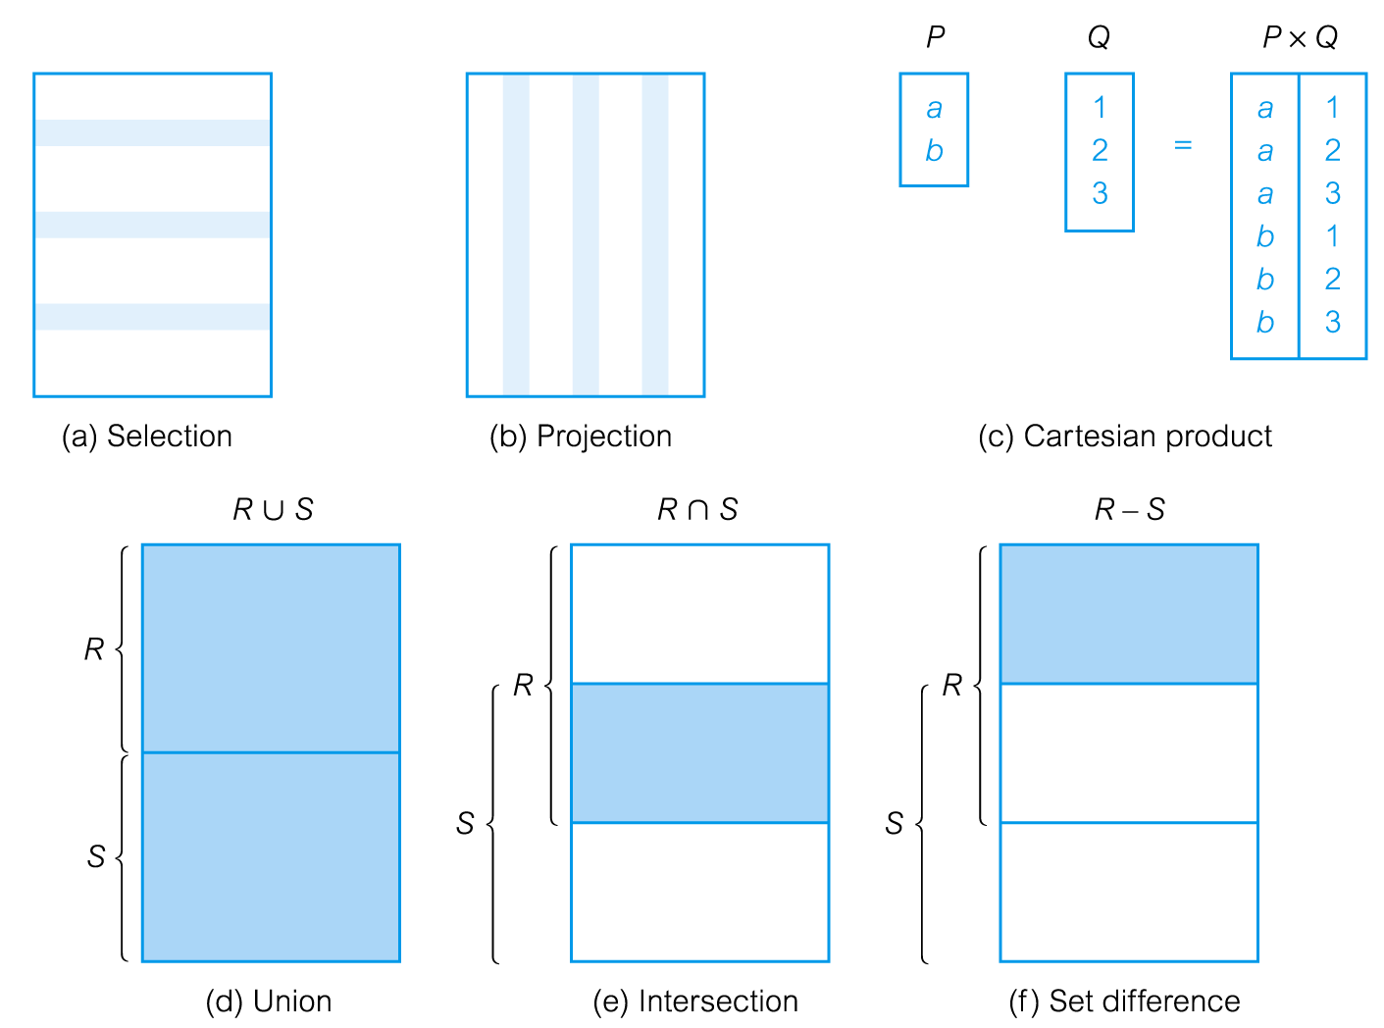
Relational Algebra Operations (1 of 2)

Slide 7
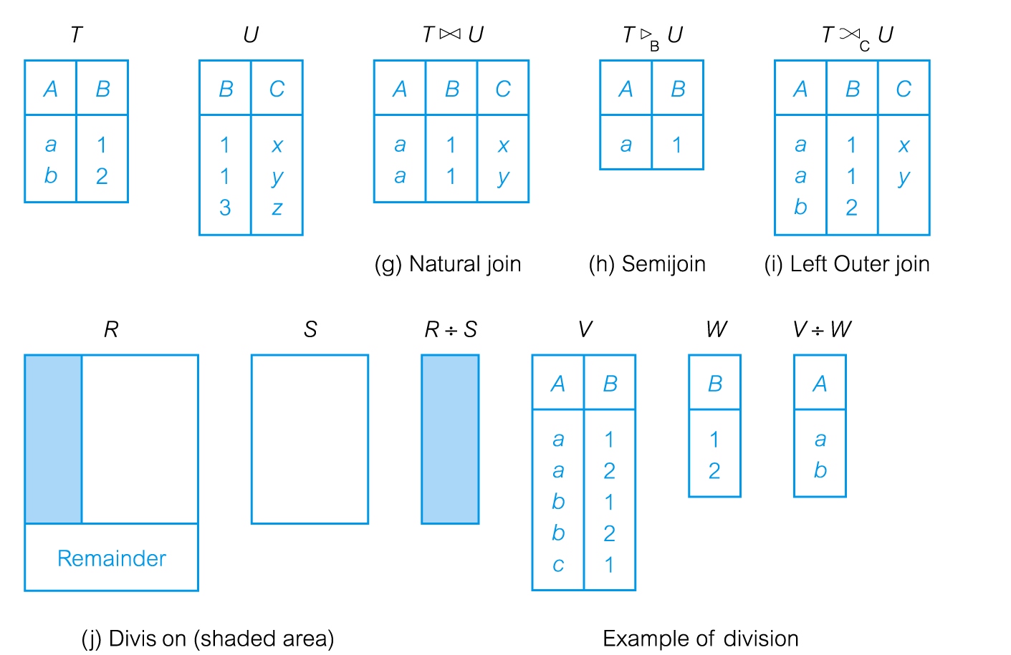
Relational Algebra Operations (2 of 2)

Slide 8
Selection (or Restriction)
Works on a single relation R and defines a relation that contains only those tuples (rows) of R that satisfy the specified condition (predicate).

Slide 9
Example - Selection (or Restriction)
List all staff with a salary greater than $10,000.
staff N o | f Name | l Name | position | sex | D O B | salary | branch N o
S L21 | John | White | Manager | M | 1-Oct-45 | 30000 | B005
S G37 | Ann | Beech | Assistant | F | 10-Nov-60 | 12000 | B003
S G14 | David | Ford | Supervisor | M | 24-Mar-58 | 18000 | B003
S G5 | Susan | Brand | Manager | F | 3-Jun-40 | 24000 | B003

Slide 10
Projection
Works on a single relation R and defines a relation that contains a vertical subset of R, extracting the values of specified attributes and eliminating duplicates.

Slide 11
Example - Projection
Produce a list of salaries for all staff, showing only staff N o, f Name, l Name, and salary details.
staff N o | f Name | l Name | salary
S L21 | John | White | 30000
S G37 | Ann | Beech | 12000
S G14 | David | Ford | 18000
S A9 | Mary | Howe | 9000
S G5 | Susan | Brand | 24000
S L41 | Julie | Lee | 9000

Slide 12
Union
Union of two relations R and S defines a relation that contains all the tuples of R, or S, or both R and S, duplicate tuples being eliminated.
R and S must be union-compatible.
If R and S have I and J tuples, respectively, union is obtained by concatenating them into one relation with a maximum of (I + J) tuples.

Slide 13
Example - Union
List all cities where there is either a branch office or a property for rent.
city
London
Aberdeen
Glasgow
Bristol

Slide 14
Set Difference
Defines a relation consisting of the tuples that are in relation R, but not in S.
R and S must be union-compatible.

Slide 15
Example - Set Difference
List all cities where there is a branch office but no properties for rent.
city
Bristol

Slide 16
Intersection
Defines a relation consisting of the set of all tuples that are in both R and S.
R and S must be union-compatible.
Expressed using basic operations:

Slide 17
Example - Intersection
List all cities where there is both a branch office and at least one property for rent.
city
Aberdeen
London
Glasgow

Slide 18
Cartesian Product
Defines a relation that is the concatenation of every tuple of relation R with every tuple of relation S.

Slide 19
Example - Cartesian Product
List the names and comments of all clients who have viewed a property for rent.
client.client N o | f Name | l Name | Viewing.client No | property N o | comment
CR76 | John | Kay | CR56 | PA14 | too small
CR76 | John | Kay | CR76 | PG4 | too remote
CR76 | John | Kay | CR56 | PG4 | Blank
CR76 | John | Kay | CR62 | PA14 | no dining room
CR76 | John | Kay | CR56 | PG36 | Blank
CR56 | Aline | Stewart | CR56 | PA14 | too small
CR56 | Aline | Stewart | CR76 | PG4 | too remote
CR56 | Aline | Stewart | CR56 | PG4 | Blank
CR56 | Aline | Stewart | CR62 | PA14 | no dining room
CR56 | Aline | Stewart | CR56 | PG36 | Blank

Slide 20
Example - Cartesian Product (2 of 2)
client.client N o | f Name | l Name | Viewing.client N o | property N o | comment
CR74 | Mike | Ritchie | CR56 | PA14 | too small
CR74 | Mike | Ritchie | CR76 | PG4 | too remote
CR74 | Mike | Ritchie | CR56 | PG4 | Blank
CR74 | Mike | Ritchie | CR62 | PA14 | no dining room
CR74 | Mike | Ritchie | CR56 | PG36 | Blank
CR62 | Mary | Tregear | CR56 | PA14 | too small
CR62 | Mary | Tregear | CR76 | PG4 | too remote
CR62 | Mary | Tregear | CR56 | PG4 | Blank
CR62 | Mary | Tregear | CR62 | PA14 | no dining room
CR62 | Mary | Tregear | CR56 | PG36 | Blank

Slide 21
Example - Cartesian Product and Selection
Use selection operation to extract those tuples where Client.client N o = Viewing.client N o.
client.clientN o | f Name | l Name | Viewing.clientN o | propertyN o | Comment
C R76 | John | Kay | C R76 | P G4 | too remote
C R56 | Aline | Stewart | C R56 | P A14 | too small
C R56 | Aline | Stewart | C R56 | P G4
C R56 | Aline | Stewart | C R56 | P G36
C R62 | Mary | Tregear | C R62 | P A14 | no dining room
Cartesian product and Selection can be reduced to a single operation called a Join.

Slide 22
Join Operations (1 of 2)
Join is a derivative of Cartesian product.
Equivalent to performing a Selection, using join predicate as selection formula, over Cartesian product of the two operand relations.
One of the most difficult operations to implement efficiently in an R D B M S and one reason why R D B M S s have intrinsic performance problems.

Slide 23
Join Operations (2 of 2)
Various forms of join operation
Theta join
Equijoin (a particular type of Theta join)
Natural join
Outer join
Semijoin

Slide 24
Theta Join (theta-Join) (1 of 2)
Defines a relation that contains tuples satisfying the predicate F from the Cartesian product of R and S.
The predicate F is of the form R.a_{i}
S.b_{i} where
may be one of the comparison operators

Slide 25
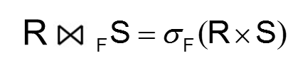
Theta Join (theta-Join) (2 of 2)
Can rewrite Theta join using basic Selection and Cartesian product operations.
Degree of a Theta join is sum of degrees of the operand relations R and S. If predicate F contains only equality (=), the term Equijoin is used.

Slide 26

Example - Equijoin
List the names and comments of all clients who have viewed a property for rent.
client.client No | f Name | l Name | Viewing.client N o | property N o | comment
C R76 | John | Kay | C R76 | P G4 | too remote
C R56 | Aline | Stewart | C R56 | P A14 | too small
C R56 | Aline | Stewart | C R56 | P G4
C R56 | Aline | Stewart | C R56 | P G36
C R62 | Mary | Tregear | C R62 | P A14 | no dining room

Slide 27
Natural Join
An Equijoin of the two relations R and S over all common attributes x. One occurrence of each common attribute is eliminated from the result.

Slide 28

Example - Natural Join
List the names and comments of all clients who have viewed a property for rent.
client N o | f Name | l Name | property N o | comment
C R76 | John | Kay | P G4 | too remote
C R56 | Aline | Stewart | P A14 | too small
C R56 | Aline | Stewart | P G4
C R56 | Aline | Stewart | P G36
C R62 | Mary | Tregear | P A14 | no dining room

Slide 29
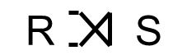
Outer Join
To display rows in the result that do not have matching values in the join column, use Outer join.
(Left) outer join is join in which tuples from R that do not have matching values in common columns of S are also included in result relation.

Slide 30

Example - Left Outer Join
Produce a status report on property viewings.
property N o | street | city | clientN o | viewDate | comment
P A14 | 16 Holhead | Aberdeen | C R56 | 24-May-01 | too small
P A14 | 16 Holhead | Aberdeen | C R62 | 14-May-01 | no dining room
P L94 | 6 Argyll St | London | null | null | null
P G4 | 6 Lawrence St | Glasgow | C R76 | 20-Apr-01 | too remote
P G4 | 6 Lawrence St | Glasgow | C R56 | 26-May-01
P G36 | 2 Manor Rd | Glasgow | C R56 | 28-Apr-01
P G21 | 18 Dale Rd | Glasgow | null | null | null
P G16 | 5 Novar Dr | Glasgow | null | null | null

Slide 31

Semijoin
Defines a relation that contains the tuples of R that participate in the join of R with S.
Can rewrite Semijoin using Projection and Join:

Slide 32
Example - Semijoin
List complete details of all staff who work at the branch in Glasgow.
staff N o | f Name | l Name | position | sex | D O B | salary | branch N o
S G37 | Ann | Beech | Assistant | F | 10-Nov-60 | 12000 | B003
S G14 | David | Ford | Supervisor | M | 24-Mar-58 | 18000 | B003
S G5 | Susan | Brand | Manager | F | 3-Jun-40 | 24000 | B003

Slide 33
Division
Defines a relation over the attributes C that consists of set of tuples from R that match combination of every tuple in S.
Expressed using basic operations:

Slide 34
Example - Division
Identify all clients who have viewed all properties with three rooms.
Result
client N o | property N o
C R56 | P A14
C R76 | P G4
C R56 | P G4
C R62 | P A14
C R56 | P G36
client N o
C R56
property N o
P G4
P G36

Slide 35
Aggregate Operations
Applies aggregate function list, A L, to R to define a relation over the aggregate list.
A L contains one or more (<aggregate_function>, <attribute>) pairs.
Main aggregate functions are: COUNT, SUM, AVG, MIN, and MAX.

Slide 36
Example – Aggregate Operations
How many properties cost more than £350 per month to rent?
myCount
5
(a)

Slide 37
Grouping Operation
Groups tuples of R by grouping attributes, G A, and then applies aggregate function list, A L, to define a new relation.
A L contains one or more (<aggregate_function>, <attribute>) pairs.
Resulting relation contains the grouping attributes, G A, along with results of each of the aggregate functions.

Slide 38
Example – Grouping Operation
Find the number of staff working in each branch and the sum of their salaries.
branch N o | my Count | my Sum
B003 | 3 | 54000
B005 | 2 | 39000
B007 | 1 | 9000

Slide 39
Relational Calculus (1 of 2)
Relational calculus query specifies what is to be retrieved rather than how to retrieve it.
No description of how to evaluate a query.
In first-order logic (or predicate calculus), predicate is a truth-valued function with arguments.
When we substitute values for the arguments, function yields an expression, called a proposition, which can be either true or false.

Slide 40
Relational Calculus (2 of 2)
If predicate contains a variable (e.g. ‘x is a member of staff’), there must be a range for x.
When we substitute some values of this range for x, proposition may be true; for other values, it may be false.
When applied to databases, relational calculus has forms: tuple and domain.

Slide 41
Tuple Relational Calculus (1 of 6)
Interested in finding tuples for which a predicate is true. Based on use of tuple variables.
Tuple variable is a variable that ‘ranges over’ a named relation: i.e., variable whose only permitted values are tuples of the relation.
Specify range of a tuple variable S as the Staff relation as:
Staff(S)
To find set of all tuples S such that P(S) is true:

Slide 42
Tuple Relational Calculus - Example
To find details of all staff earning more than $10,000:
To find a particular attribute, such as salary, write:

Slide 43
Tuple Relational Calculus (2 of 6)
Can use two quantifiers to tell how many instances the predicate applies to:
Existential quantifier
(‘there exists’)
Universal quantifier
(‘for all’)
Tuple variables qualified by
are called bound variables, otherwise called free variables.

Slide 44
Tuple Relational Calculus (3 of 6)
Existential quantifier used in formulae that must be true for at least one instance, such as:
Means ‘There exists a Branch tuple with same branch N o as the branch N o of the current Staff tuple, S, and is located in London’.

Slide 45
Tuple Relational Calculus (4 of 6)
Universal quantifier is used in statements about every instance, such as:
Means ‘For all Branch tuples, the address is not in Paris’.
Can also use
(B.city = ‘Paris’) which means
‘There are no branches with an address in Paris’.

Slide 46
Tuple Relational Calculus (5 of 6)
Formulae should be unambiguous and make sense.
A (well-formed) formula is made out of atoms:
R(S_{i}), where S_{i} is a tuple variable and R is a relation
Can recursively build up formulae from atoms:
An atom is a formula
If F₁ and F₂ are formulae, so are their conjunction,
disjunction,
and negation,
If F is a formula with free variable X, then
are also formulae.

Slide 47
Example - Tuple Relational Calculus (1 of 3)
List the names of all managers who earn more than $25,000.
List the staff who manage properties for rent in Glasgow.

Slide 48
Example - Tuple Relational Calculus (2 of 3)
List the names of staff who currently do not manage any properties.
Or

Slide 49
Example - Tuple Relational Calculus (3 of 3)
List the names of clients who have viewed a property for rent in Glasgow.

Slide 50
Tuple Relational Calculus (6 of 6)
Expressions can generate an infinite set. For example:
To avoid this, add restriction that all values in result must be values in the domain of the expression.

Slide 51
Domain Relational Calculus (1 of 2)
Uses variables that take values from domains instead of tuples of relations.
If F
stands for a formula composed of
composed of atoms and
represent domain,
then:
is a general domain relational calculus expression.

Slide 52
Example - Domain Relational Calculus (1 of 4)
Find the names of all managers who earn more than $25,000.

Slide 53
Example - Domain Relational Calculus (2 of 4)
List the staff who manage properties for rent in Glasgow.

Slide 54
Example - Domain Relational Calculus (3 of 4)
List the names of staff who currently do not manage any properties for rent.

Slide 55
Example - Domain Relational Calculus (4 of 4)
List the names of clients who have viewed a property for rent in Glasgow.

Slide 56
Domain Relational Calculus (2 of 2)
When restricted to safe expressions, domain relational calculus is equivalent to tuple relational calculus restricted to safe expressions, which is equivalent to relational algebra.
Means every relational algebra expression has an equivalent relational calculus expression, and vice versa.

Slide 57
Other Languages (1 of 2)
Transform-oriented languages are non-procedural languages that use relations to transform input data into required outputs (e.g. S Q L).
Graphical languages provide user with picture of the structure of the relation. User fills in example of what is wanted and system returns required data in that format (e.g. Q B E).

Slide 58
Other Languages (2 of 2)
4G Ls can create complete customized application using limited set of commands in a user-friendly, often menu-driven environment.
Some systems accept a form of natural language, sometimes called a 5G L, although this development is still at an early stage.

